Slide 1
Resistance to viral diseases
Plant viral diseases are difficult to control
Research in mid 1980;s showed that transgenic tobacco expressing the coat protein gene of TMV is resistant to TMV and it was speculated that the resistance is the result of the interference with virus uncoating by the expressed coat protein.
A number of other Plant RNA viruses, TMV, CMV, alfalfa mosaic virus and several potato virusues – showed protection
The protection is now known to be the result of RNA silencing, a cell based sequence specific post transcriptional RNA degradation system that is programmed by the transgene-encoded RNA sequence.
In recent uears, transgenic plants have been engineered with a variety of other sequences, encoding either the viral proteins or RNA’s that confer virus resistance.

Slide 2
Nitrogen fixation
Leguminous plants, including crops like soybeans, lentils, peas which are high in protein and carbs form symbiotic association with species of Rhizobium, Bradyrhizobium and Frankia that fix atmospheric molecular nitrogen
This associatin leads to the formation of root nodules within which the Rhizobia proliferate.
Long practice to add Rhizobia to soil- reduces the need of nitrogenous fertilizers.
Strians of B.japonicum and R.meliloti, engineered to increase the expression of certain genes important to nitrogen fixation.
Transfer of genes for nodule formation to Agrobacterium enables the recombinant organisms to initiate nodulation on non-legumes for nitrogen fixation.
This goal shall require manipulation of the host as well as the bacterial genes.

Slide 3
Food technology:
Preparation of fermented foods:
Use of MO’s for fermented food – long history.
Microbial fermentation – essential for the production of wine, beer, buttermilk, cheese, kefir, olives sauerkraut and many many more.
Metabolic end products – flavor fermented foods – mold ripened cheese etc.
Lactic acid bacteria – LAB – widely used to produce fermented foods.
LAB’s also produce peptides and proteins (bacteriocins) that inhibit the growth of undesirable organisms that cause food spoilage and the multiplication of food borne pathogens.
Ex. Clostridium botulinum – botulism
Listeria monocytogenes – meningoencephalitis, meningitis and other disorders in humans.

Slide 4
Nisin
Antibacterial peptide produced by strains of Lactococcus lactis.
It inhibits the growth of a wide range of G+ve bacteria like Listeria, Clostridium, Bacillus and Enterococci.
Activity is the combined outcome of its high-affinity interaction with lipid II at the outer leaflet of the bacterial cytoplasmic membrane and permeabilization of the membrane through pore formation.
GRAS stutus – used in many food products, including pasteurized cheese spreads with fruits, vegetables or meats, liquid egg products, dressings and sauces, beers, canned foods, frozen deserts.
Lactobacillus sakei: A promising Biopreservative – Psychrophilic lactic acid bacterium – isolated from sake, a Japanese beer that is produced partly by lactic acid fermentation.
These strains dominated the spontaneous fermentation of meat – salami and other dry fermented sausages.
Major component of the microbial flora of processed food products stored at low temperature.

Slide 5
L. sakei
Also a transient inhabitant of human gut.
These organisms called probiotic species – stimulate immune response and suppress growth of potentially pathogenic bacteria.
Genome of L.sakei (23K) isolated from French sausage – completely sequenced and has 43% identity to L.acidophilus.
Good choice to be used as a biopreservative – genome codes for four proteins – predicted to be involved in cell-cell interaction and in binding to collagen exposed on the surface of meat.
Two other gene clusters – function in the production of surface polysaccharides that many contribute to the attachment of the bacterium to the meat surface – these might mediate the aggregation of L.sakei and formation of a biofilm on the meat surface that would exclude MO’s.
Meat undergoes autoproteolysis on aging with release of AA – excellent ecological niche.
L.sakei is well adapted to low temperature and osmotic stress – meat storage required refrigeration and salts (9% NaCl)
Has high number of putative cold stress proteins – also has uptake systems for the efficient accumulation of osmo and cryoprotective solutes.
Also well equipped with enzymes that detoxify reactive oxygen species such as superoxide or organic hydroperoxides generated during meat processes
Takes up both heme and iron from the meat. Competition for iron may represent yet another important factor in the ability of L.sakei to exclude other organisms from the meat surface.

Slide 6
Single cell protein
Describes the protein-rich cell mass derived from MO’s grown on a large scale for either animal or human consumption.
MO’s excellent source of SCP – growth rate, use inexpensive raw materials as carbon sources – uniquely high efficiency expressed as grams of protein produced/kg of raw material.
Mycoprotein – the processed cell mass preparation of Fusarium venenatum – grown under aeration under steady state conditions – prevent the production of highly toxic mytotoxins – if growth is limited by nutrient limitation – final product is analysed for any mycotoxins by HPLC and other mass spectrometric detectors.
Close to 50% of dry weight is protein containing all the essential AA – 25% contains cell wall compents etc, Fat-12%.
Chlorella – single cell algae – high in chlorophyll, protein and Omega 3
Spirulina – Biomass of BGA, contains minerals, proteins, vitamins, antioxidants etc. Fighting anemia, good for blood and heart related diseases.

Slide 7
Environmental applications of Microorganisms
Waste water treatment:
Water – important for everything – freshwater only 2.5% - Now there is a scarcity of water resources around the world.
Volume of water being contaminated – many ways
Waste water originates from – sewage, industrial effluents, agricultural runoff, urban runoff etc.
Treatment of waster water – essential to prevent contamination of drinking water – contaminants like heavy metals, polycyclic aromatic hydrocarbons, chlorinated biphenyls, nitrosamines, aromatic hydrocarobons etc etc.
Sewage treatment -

Slide 8
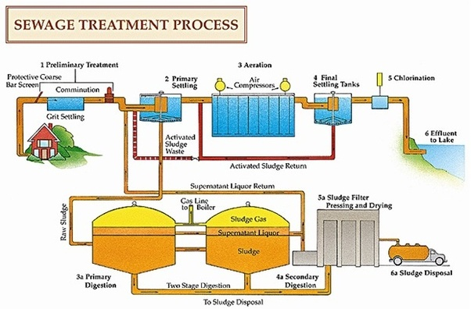

Slide 9
Bioremediation
Bioremediation is a process where biological organisms are used to remove or neutralize an environmental pollutant by metabolic process. The “biological” organisms include microscopic organisms, such as fungi, algae and bacteria, and the “remediation”—treating the situation.
Microbial bioremediation uses microorganisms to break down contaminants by using them as a food source.
Phytoremediation uses plants to bind, extract, and clean up pollutants such as pesticides, petroleum hydrocarbons, metals, and chlorinated solvents.
Bioremediation works by providing these pollution-eating organisms with fertilizer, oxygen, and other conditions that encourage their rapid growth. These organisms would then be able to break down the organic pollutant at a correspondingly faster rate. In fact, bioremediation is often used to help clean up oil spills.

Slide 10
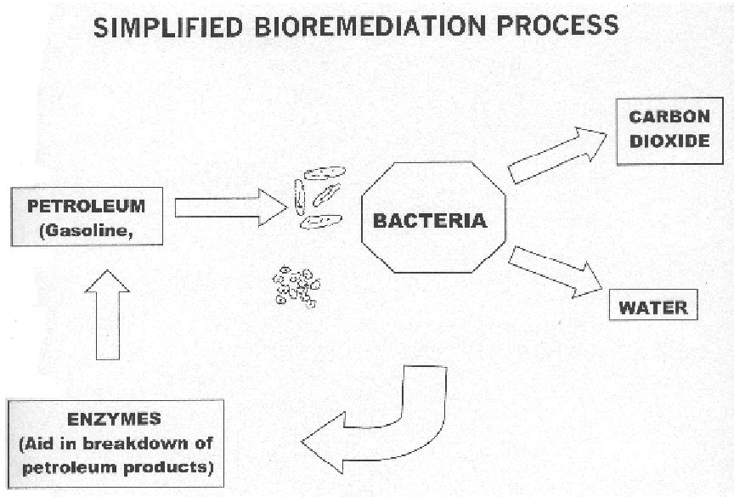

Slide 11
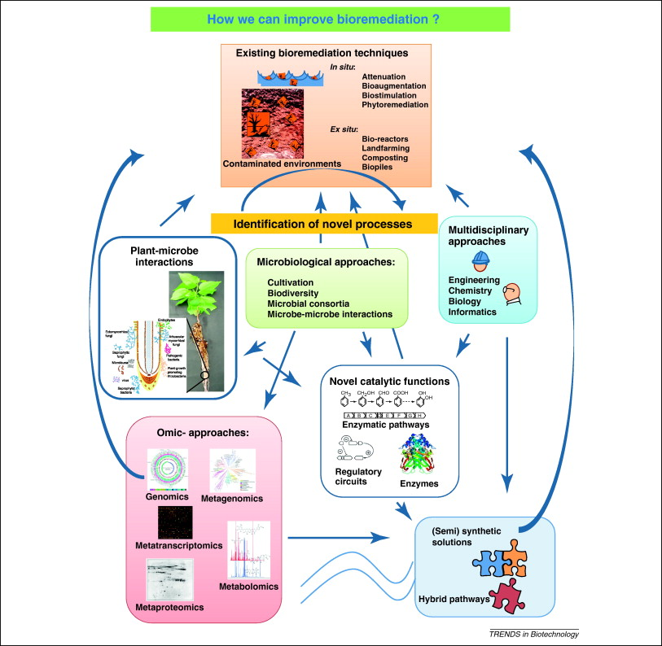

Slide 12
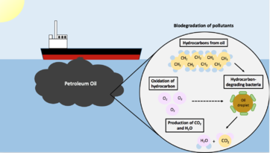

Slide 13
Deinococcus radiodurans
Deinococcus radiodurans is an extremophilic bacterium and one of the most radiation-resistant organisms known. It can survive cold, dehydration, vacuum, and acid, and therefore is known as a polyextremophile. It has been listed as the world's toughest known bacterium in The Guinness Book Of World Records.
Thousands of waste sites around the world contain mixtures of toxic chlorinated solvents, hydrocarbon solvents, and radionuclides.
Because of the inherent danger and expense of cleaning up such wastes by physicochemical methods, other methods are being pursued for cleanup of those sites. One alternative is to engineer radiation-resistant microbes that degrade or transform such wastes to less hazardous mixtures.
The construction and characterization of recombinant Deinococcus radiodurans, the most radiation-resistant organism known, expressing toluene dioxygenase (TDO). Cloning of the tod genes (which encode the multicomponent TDO) into the chromosome of this bacterium imparted to the strain the ability to oxidize toluene, chlorobenzene, 3,4-dichloro-1-butene, and indole.

Slide 14
Deinococcus radiodurans
The recombinant strain was capable of growth and functional synthesis of TDO in the highly irradiating environment (60 Gy/h) of a 137Cs irradiator, where 5x10(8)cells/ml degraded 125 nmol/ml of chlorobenzene in 150 min.
D. radiodurans strains were also tolerant to the solvent effects of toluene and trichloroethylene at levels exceeding those of many radioactive waste sites.
These data support the prospective use of engineered D. radiodurans for bioremediation of mixed wastes containing both radionuclides and organic solvents.

Slide 15
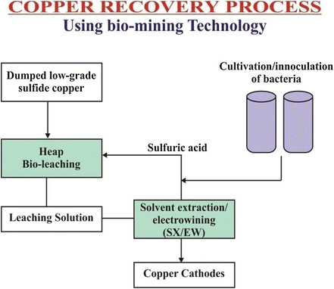
Biomining
Biomining is the process of using microorganisms (microbes) to extract metals of economic interest from rock ores or mine waste.
Biomining techniques may also be used to clean up sites that have been polluted with metals. Valuable metals are commonly bound up in solid minerals.

Slide 16
Bioleaching
Bioleaching can involve numerous ferrous iron and sulfur oxidizing bacteria, including Acidithiobacillus ferrooxidans (formerly known as Thiobacillus ferrooxidans) and Acidithiobacillus thiooxidans (formerly known as Thiobacillus thiooxidans).
As a general principle, Fe³⁺ ions are used to oxidize the ore.
Several species of fungi can be used for bioleaching. Fungi can be grown on many different substrates, such as electronic scrap, catalytic converters, and fly ash from municipal waste incineration.
Experiments have shown that two fungal strains (Aspergillus niger, Penicillium simplicissimum) were able to mobilize Cu and Sn by 65%, and Al, Ni, Pb, and Zn by more than 95%.
Aspergillus niger can produce some organic acids such as citric acid. This form of leaching does not rely on microbial oxidation of metal but rather uses microbial metabolism as source of acids that directly dissolve the metal.
Many thermophillic microorgansims – oxidises bivalent ions, elemenatary sulfur and sulfies and leach mobdenite and chalcopyrite. Acido-thermophillic bacteria – Sulfolobus brierleyi and other species of Sulfolobus.

Slide 17
